Slide 1
RCL.PL.THM1
RVM Requirement Number | 1
RVM Requirement Wording | All CubeSat components shall be rated to withstand a temperature range of at least -20 ⁰C to 70 ⁰C
Validation Method | Analysis
For those components that are developed at the SSRL, each component that is used in its assembly will be rated to operate within said range.

Slide 2
RCL.PL.PRP2
RVM Requirement Number | 2
RVM Requirement Wording | Static Thrust testing will be performed with the flight pressure vessel prior to CubeSat integration at a pressure no greater than 1x10^-4 Torr
Validation Method | Test
The propulsion system must pass the static test fire with no anomalies to meet this requirement.

Slide 3
RCL.PL.PRP3
RVM Requirement Number | 3
RVM Requirement Wording | The pressure vessel must pass thermal cycle testing between temperatures of -30 ⁰C and 70 ⁰C for a total of two cycles or 10 hours
Validation Method | Test
The propulsion system shall perform static thrusts before the thermal cycle, during the cycle at various points, and finally, after the thermal cycle.

Slide 4
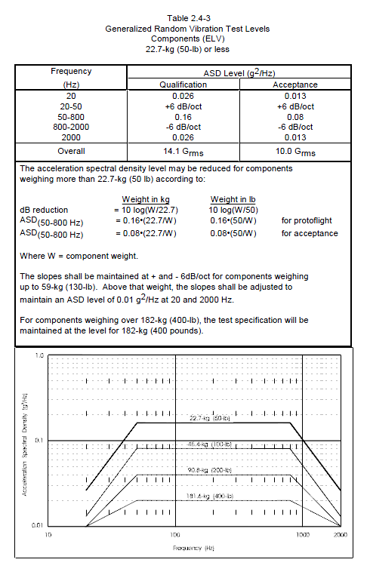
RCL.PL.TST1
RVM Requirement Number | 1
RVM Requirement Wording | CubeSat must survive Random Vibration Testing relative to the NASA GEVS Qualification Profile
Validation Method | Test
Using the GEVS profile covers as many vibration environments as possible.

